Slide 2

Automation using Protractor – Session 1
- Abhay Singh - Reetika Nigam

Slide 3
Brief Outline
Introduction
WebDriver JS
Why Protractor
Protractor vs Selenium
Why to use Protractor over Selenium for Angular Apps
How Protractor Works
How to set up Protractor
Protractor commands
Hands On

Slide 4
Introduction to Protractor
Protractor is an end-to-end testing framework for AngularJS applications and works as a solution integrator combining powerful tools and technologies such as NodeJS, Selenium WebDriver, Jasmine, Cucumber and Mocha.
Now protractor supports both angular and Non-Angular applications.
The protractor is wrapper written on top of Webdriver.js, all the features which are supported in Selenium Webdriver are supported by it, in addition to angular specific features.
WebDriverJs is the Official JavaScript implementation of selenium. It uses the Selenium JSON-Wire-Protocol to interact with the browser as selenium java does. Protractor depends on WebdriverJs to interact with the browser.
Angular JS applications have some extra HTML attributes like ng-repeater, ng-controller, ng-model.., etc. which are not included in Selenium locators. Selenium is not able to identify those web elements using Selenium code. So, Protractor on the top of Selenium can handle and controls those attributes in Web Applications.

Slide 5
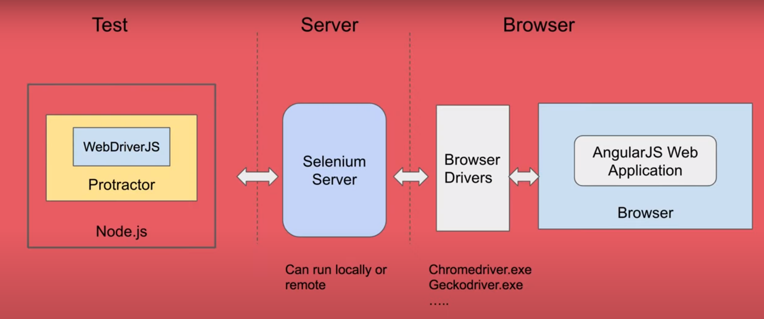
Introduction to Protractor

Slide 6
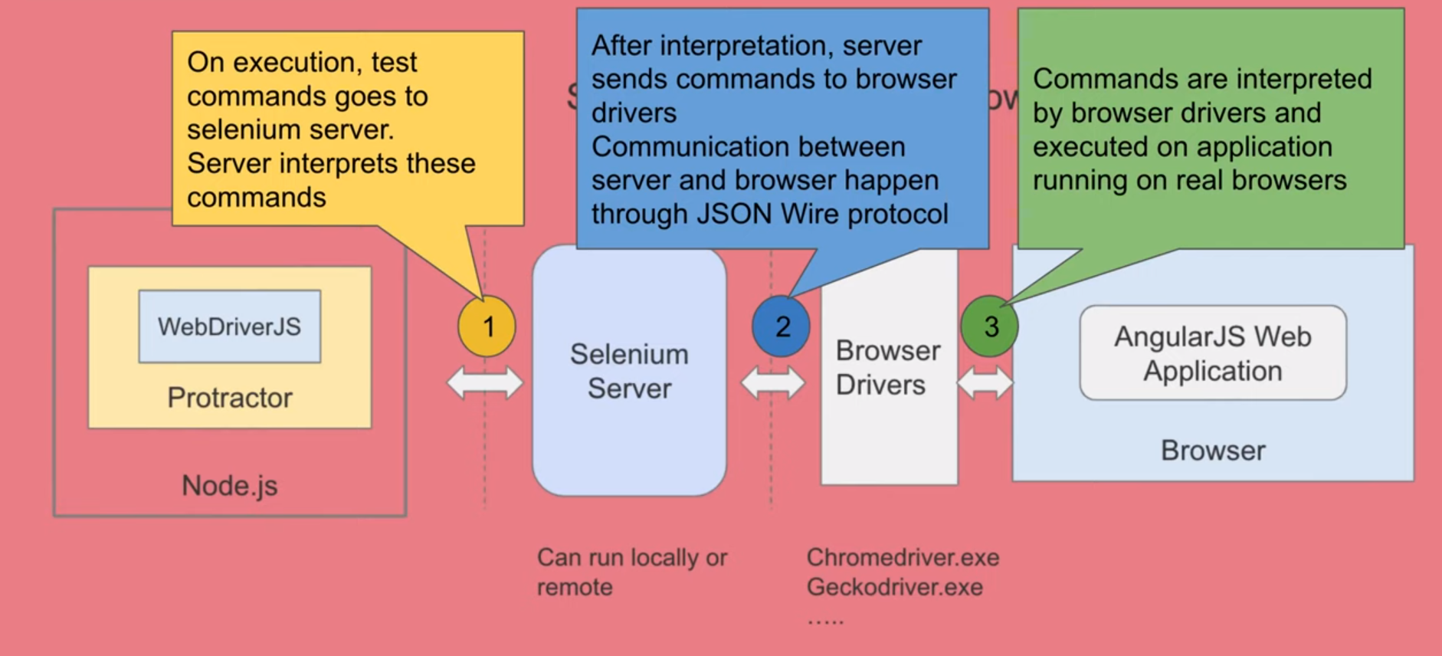
Introduction to Protractor

Slide 7
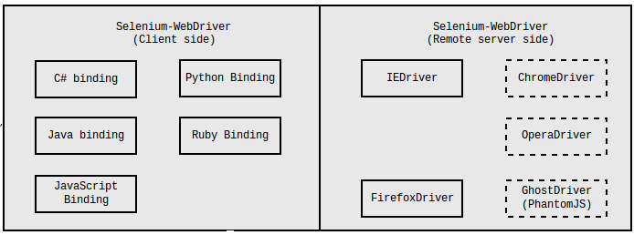
WebDriverJS
WebDriverJs is the Official JavaScript implementation of selenium. It is written by selenium guys and protractor depends on it to interact with browser.
JSON Wire Protocol for various language binding to communicate with the browser controller.
JavaScript is the latest addition in the language binding of webdriver, which is known as webdriverjs.
WebDriverJs is simply a wrapper over the JSON Wire Protocol exposing high level functions.

Slide 8
Why Protractor?
Angularjs needs to identify the elements which are not recognized by selenium for ex: ng-model, css etc.
Protractor provides some new locator strategies and functions which are very helpful to automate the AngularJS application. Examples include things like:
waitForAngular
By.binding
By.repeater,
By.textarea
By.model
WebElement.all,
WebElement.evaluate
It supports multiple browsers like chrome,firefox,safari and IE .It can run parallel test using the multiCapabilities configuration option
Supports the Jasmine, Mocha, and Cucumber BDD test frameworks

Slide 9
Why Protractor?
Angular (like pure javascript) is mostly asynchronous throughout and makes use of promises to handle asynchronous call.
Synchronous Programming : In a synchronous programming model, things happen one at a time. Each operation has to wait for the previous one to be completed, before it can be executed.
Asynchronous Programming : An asynchronous model allows multiple things happen at the same time. Operations can be executed WHILE the query is being processed.

Slide 10
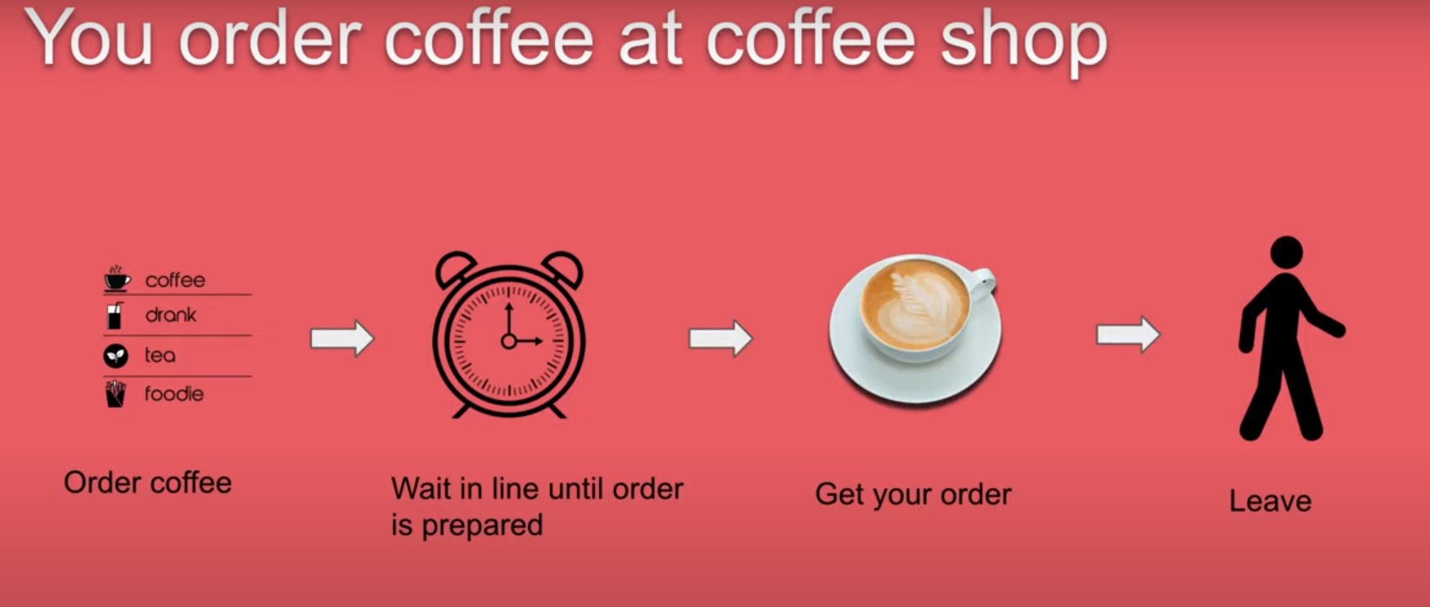
Why Protractor?

Slide 11
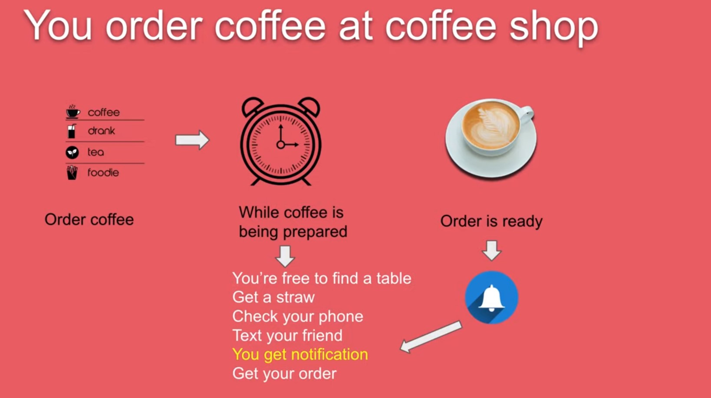
Why Protractor?

Slide 12
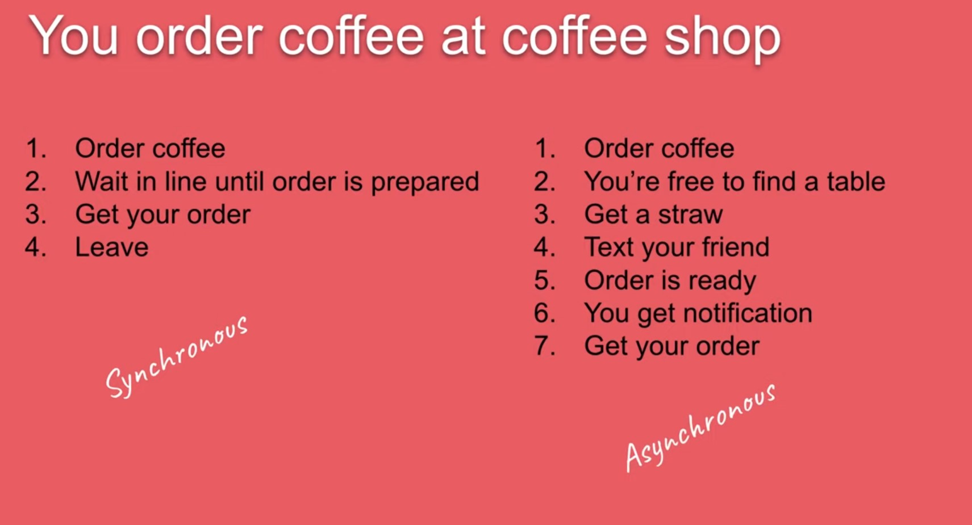
Why Protractor?

Slide 13
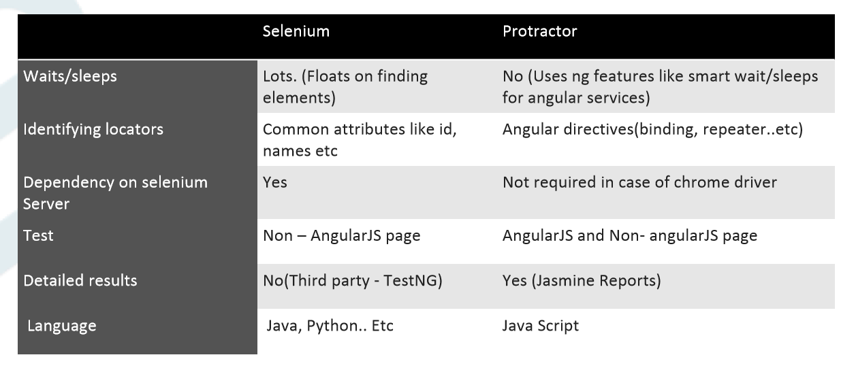
Protractor vs Selenium

Slide 14
Protractor over Selenium for AngularJS
Wrapper around WebDriverJs and supports Behaviour Driven Development Frameworks such as Jasmine, Cucumber, Mocha etc.
Works in conjunction with Selenium. It offers some other new locator strategies that automate the testing of AngularJS applications.
Makes use of Selenium Grid to run Multiple browsers at once.
Handles the $http or $timeout synchronisation issues arising out of Angular/Angular JS very well.
Angular/Angular JS code is written in JavaScript/TypeScript, and Protractor supports both these languages.
Protractor has hooks into angular (monitors that the page is loaded or not and waits for it)

Slide 15
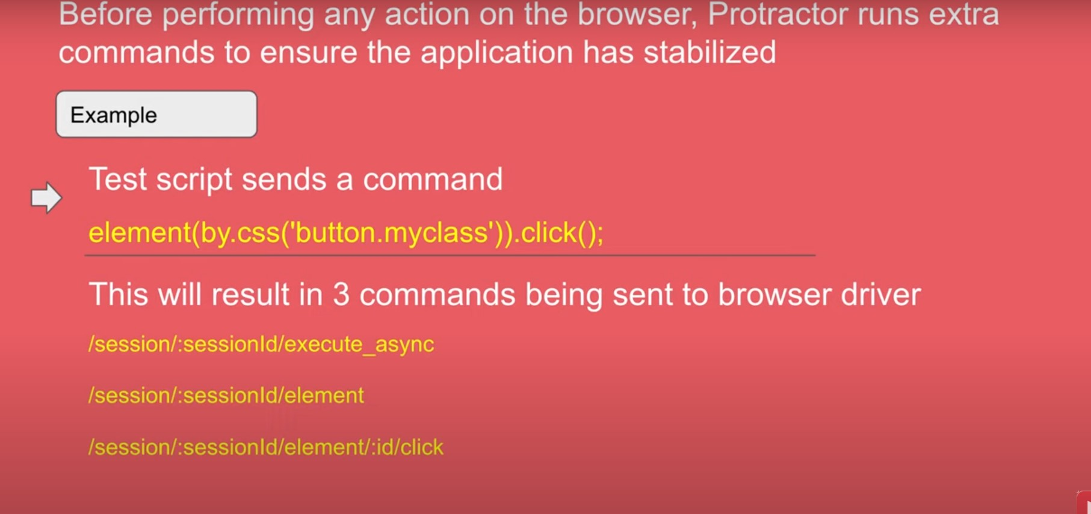
How Protractor Works

Slide 16
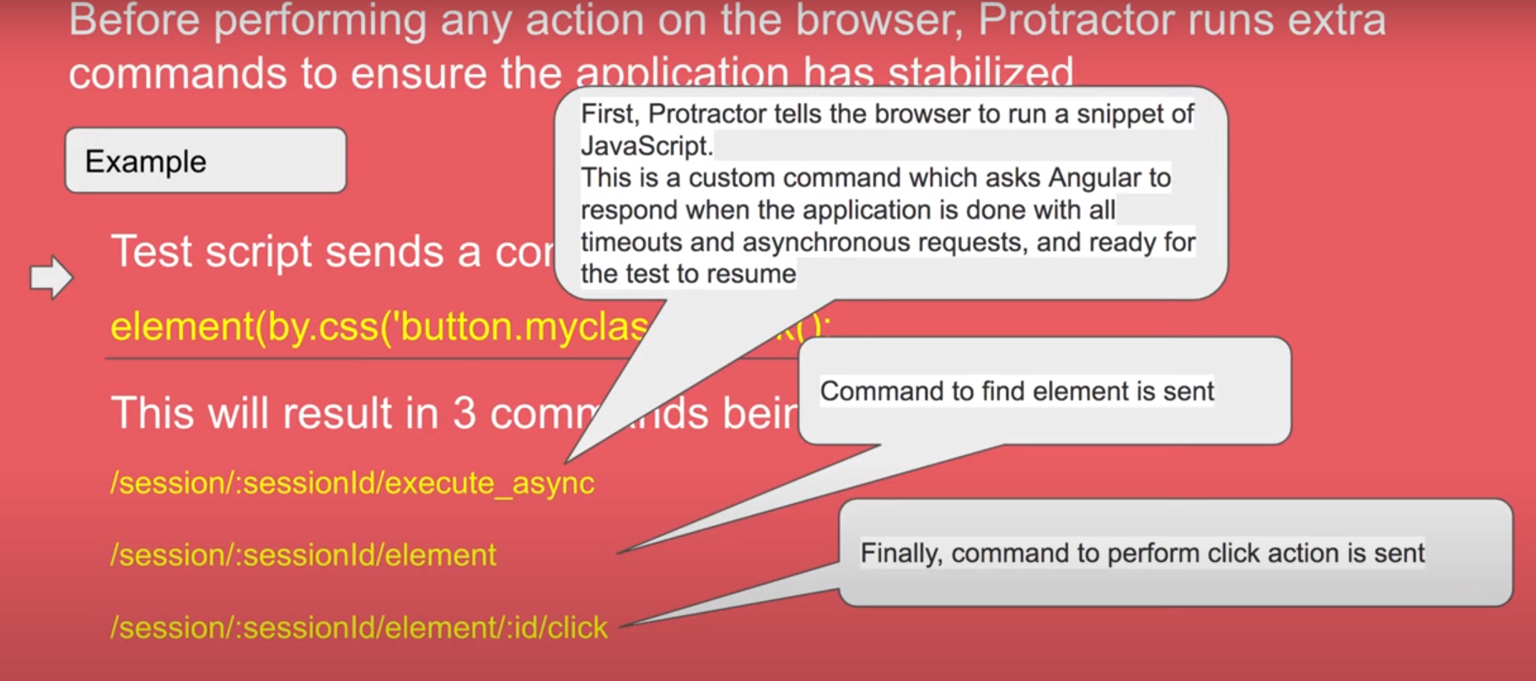
How Protractor Works

Slide 17
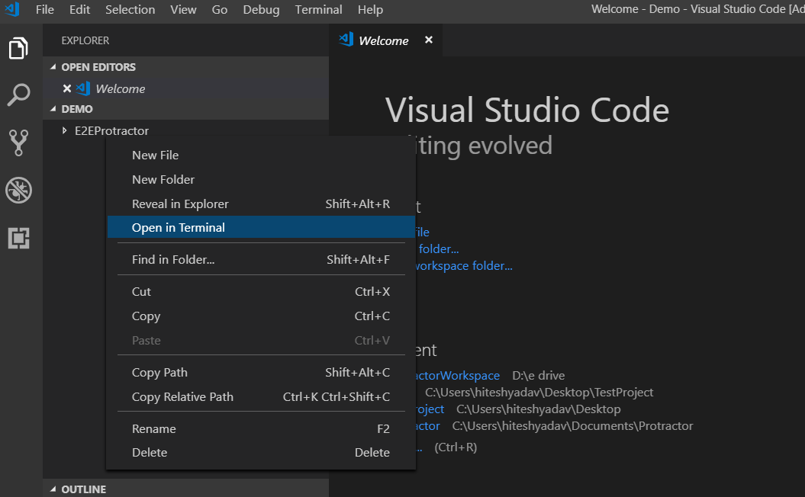
How to setup Protractor
Pre-requisites:
Install Java Development Kit (JDK)
Install Node.js
Install Visual Studio Code
STEPS:
Create a folder and a sub folder inside it anywhere on local drive
Open visual studio code and browse the same root folder
Right click on sub folder and click ‘open in terminal’

Slide 18
Set-ExecutionPolicy -Scope CurrentUser -ExecutionPolicy Unrestricted
How to setup Protractor
In Terminal type:
npm init -y
npm install –g protractor
npm install protractor --save-dev
webdriver-manager update
Set-ExecutionPolicy -Scope CurrentUser -ExecutionPolicy Unrestricted (for people facing policy issue)
webdriver-manager start
Check http://localhost:4444/wd/hub/static/resource/hub.html in browser
Add conf.js and spec.js to folder structure.
To run the project:
In New terminal from same directory type:
1. Protractor conf.js

Slide 19
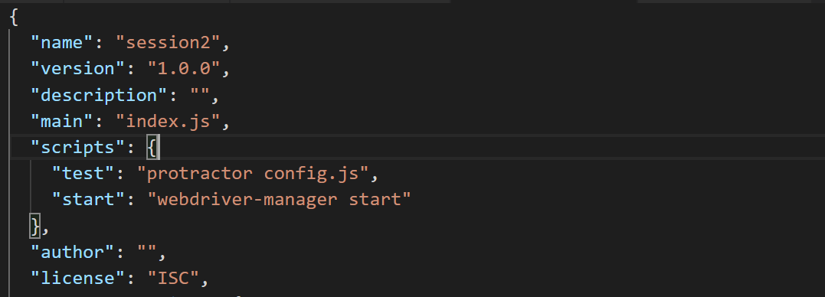
Package.json
To run project, ‘npm run test’ can also be used

Slide 20
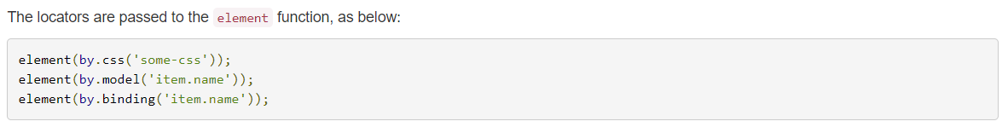
Protractor Commands
Global Variables -
browser : A wrapper around an instance of WebDriver, used for navigation and page-wide information. The browser.get() method loads a page. Protractor expects Angular to be present on a page. For non-angular, you may access the wrapped webdriver instance directly with browser.driver
element : A helper function for finding and interacting with DOM elements on the page you are testing. The element function searches for an element on the page.
by - A collection of element locator strategies. For example, elements can be found by CSS selector, by ID, or by the attribute they are bound to with ng-model.
Locator Strategy –
Protractor exports a global function element, which takes a Locator and will return an ElementFinder. This function finds a single element - if you need to manipulate multiple elements, use the element.all function.

Slide 21
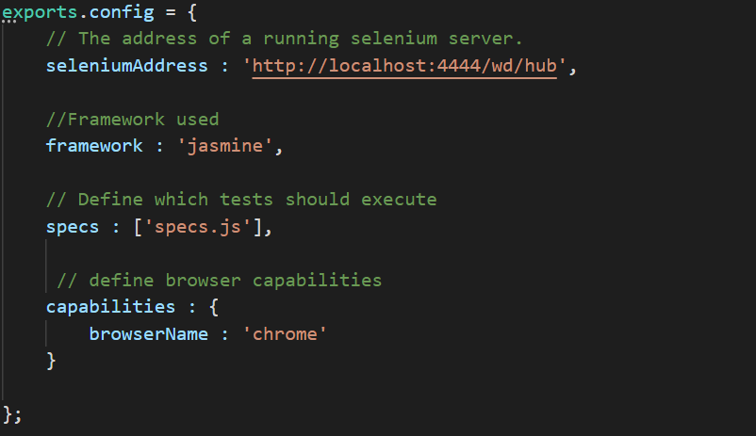
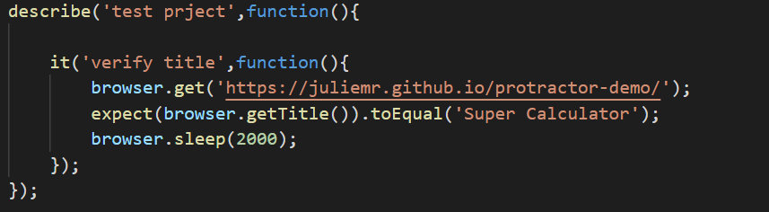
How to setup Protractor
config.js
Spec.js

Slide 22
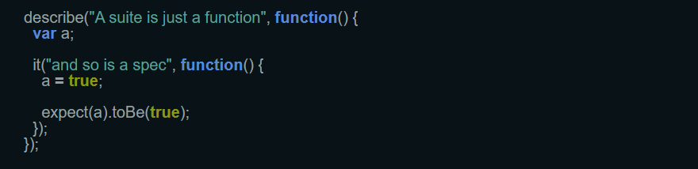
Jasmine Framework
Jasmine test case consist of suites and specs.
Suites(describe Your Tests) : The describe function is for grouping related specs, typically each test file has one at the top level. Naming the collection of specs,and will be concatenated with specs to make a spec's full name. This aids in finding specs in a large suite.
Specs(it blocks) : takes a string and a function. The string is the title of the spec and the function is the spec, or test. A spec contains one or more expectations that test the state of the code.

Slide 23
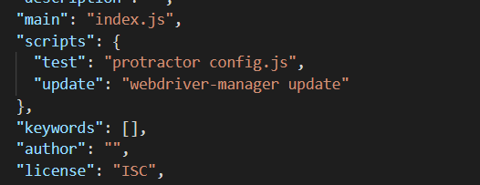
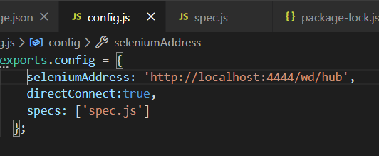
Running the protractor Tests
Run the following command from config File Directory:
protractor config.js
*config.js is the file name.
To run using directConnect property
Set the directConnect:true in config.js
add "update": "webdriver-manager update" to package.json scripts section [Optional step who face the error 135]
Run the npm run update
You’re good to run your test without running the Server.

Slide 24
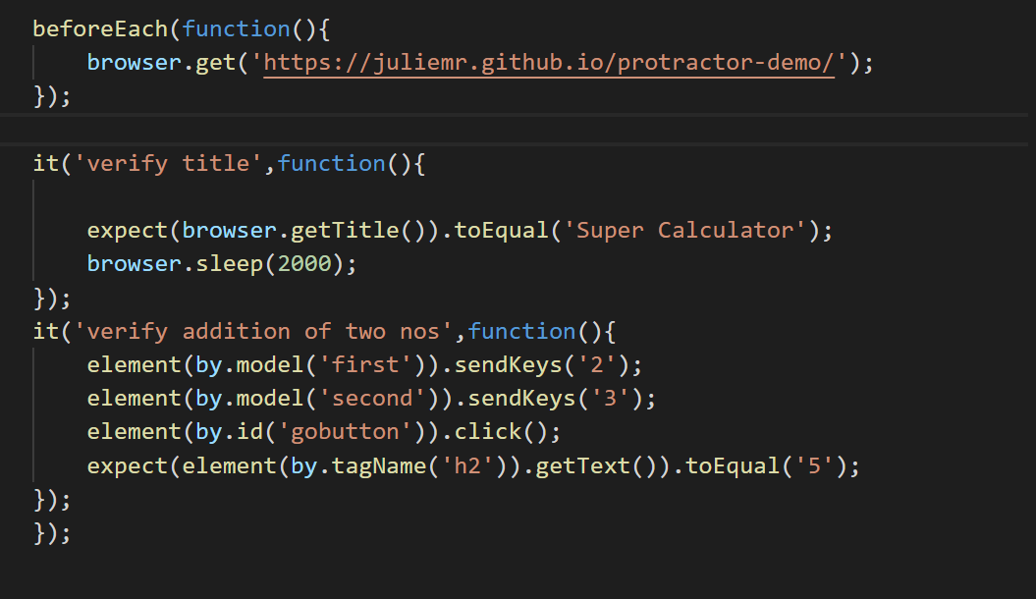
Spec.js

Slide 25


Slide 26
Quality at the speed of digital Thank YOU

